Slide 1
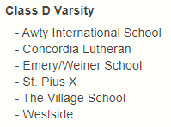
THSLL South Class D
REGULAR SEASON PLAY:
You must play every team in the division once. If you play a team twice, you must designate which game will count as the district game. Tie breakers, listed in priority are head to head, goals for against division opponents, goals against division opponents, coin flip.

Slide 2
THSLL South Class D Playoffs
All Teams Make The Playoffs
Six Team Playoff
Teams are Seeded by Divisional Standing
The City Champion makes the State Playoffs

Slide 3
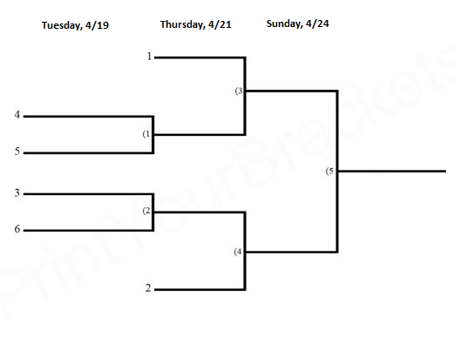
THSLL South Class D Playoffs

Slide 4
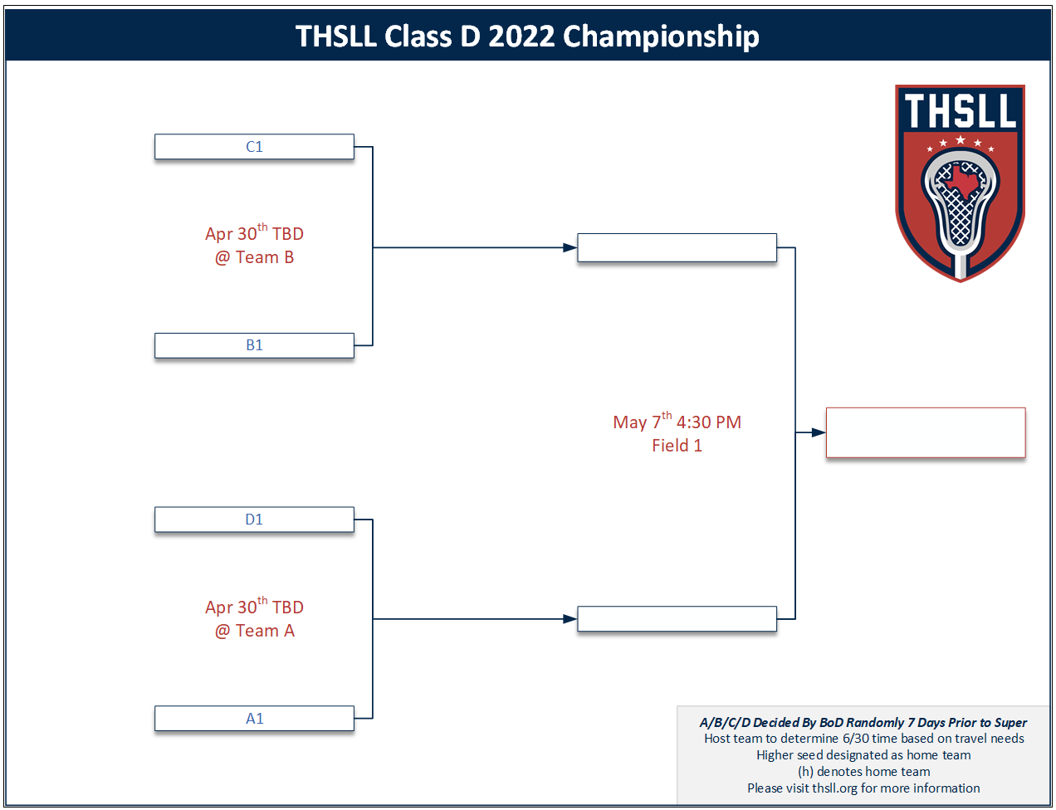

Slide 5
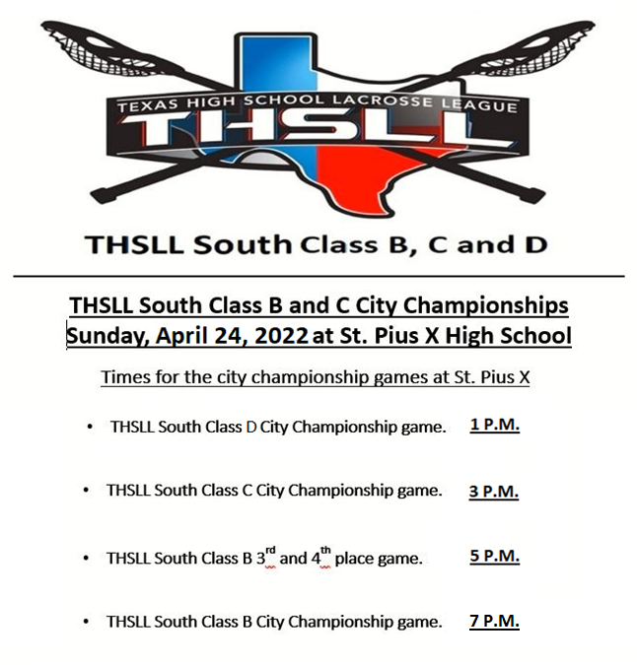

Slide 6
THSLL South All Star Games:
Sunday, May 15, 2022, Stratford will host
12:30 PM: THSLL South Class D All Star game.
2:45 PM: THSLL South Class C All Star game.
5:00 PM: THSLL South Class B All Star game.

