Slide 1
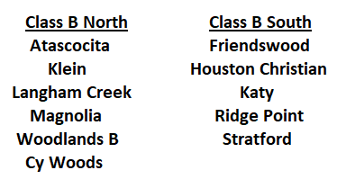
THSLL South Class B
REGULAR SEASON PLAY:
You must play every team in the division once. If you play a team twice, you must designate which game will count as the district game. Tie breakers, listed in priority are head to head, goals for against division opponents, goals against division opponents, coin flip.

Slide 2
THSLL South Class B Playoffs
Ten Team Playoff
Teams are Seeded by Divisional Standing
Six teams move on to the State Super Regionals

Slide 3
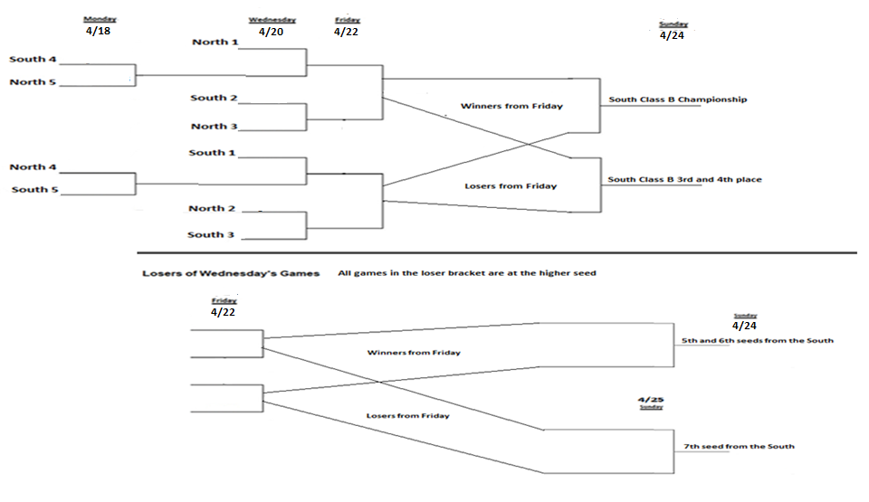
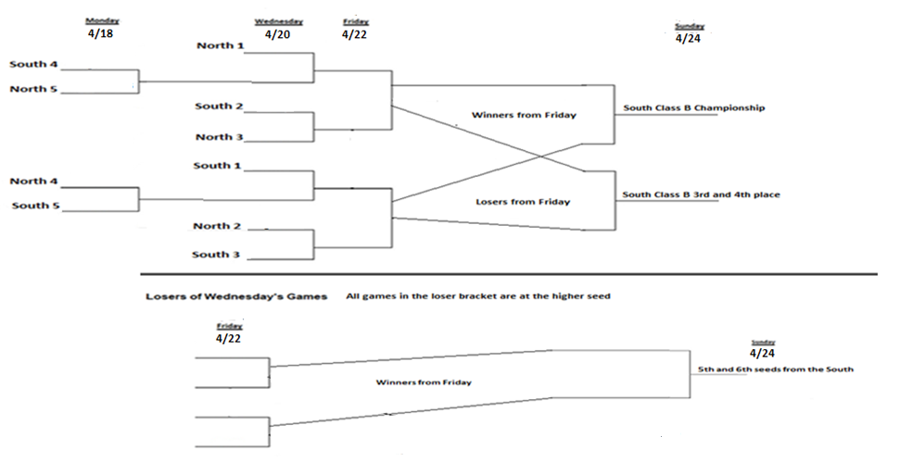
2022 THSLL South Class B
Playoff Structure
THSLL South Class B
Ten teams make the playoffs.
Top five in each division.

Slide 4
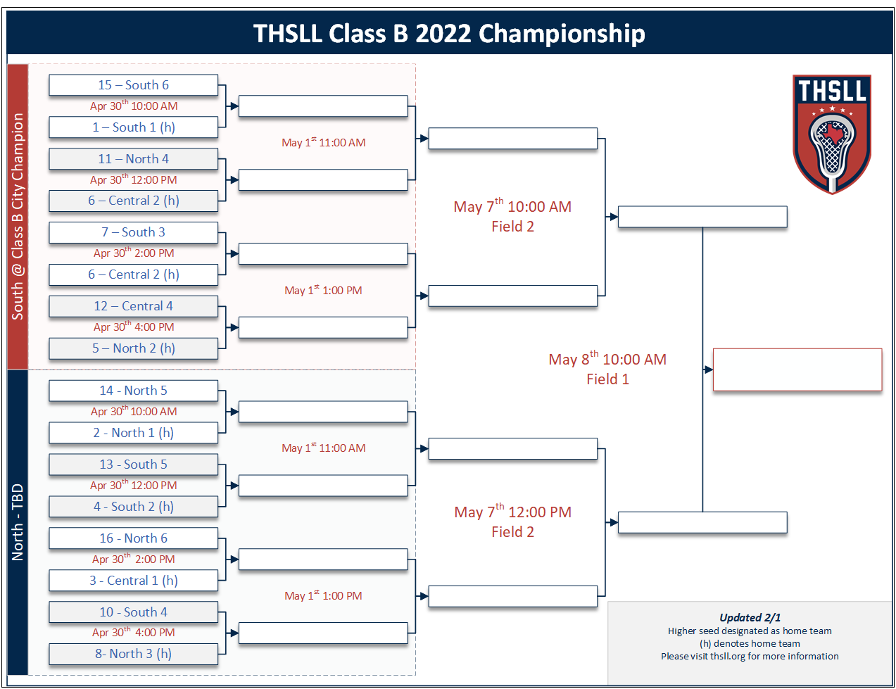

Slide 5
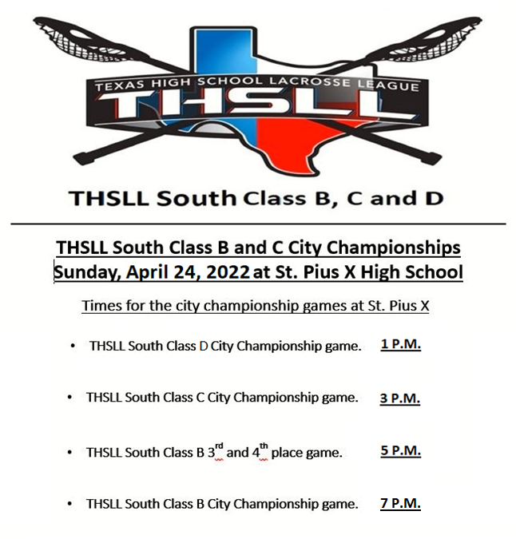

Slide 6
THSLL South All Star Games:
Sunday, May 15, 2022, Stratford will host
12:30 PM: THSLL South Class D All Star game.
2:45 PM: THSLL South Class C All Star game.
5:00 PM: THSLL South Class B All Star game.

